Slide 1
Index
For fast access to data.
The size is much smaller than the data set.
Index elements are sorted.
They are kept in file structure such as B-TREE.

Slide 2
Index
_id will be indexed by default.
Single key
db.FIT.createIndex( { name.last: -1 } )
Compound key
db.FIT.createIndex( { name.last: -1 },{name.first: -1} )

Slide 3
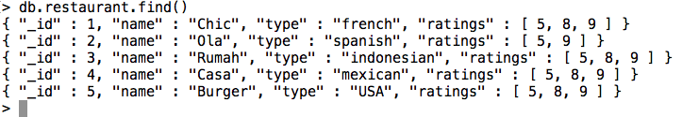
Index on Array - Multikeys
db.restaurant.createIndex( { ratings: 1 } )

Slide 4
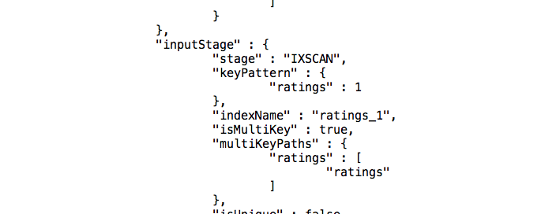
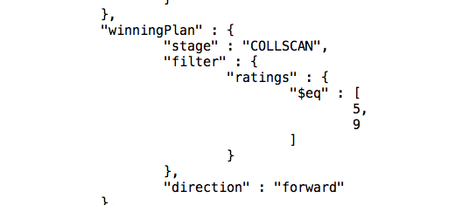
Showing Query Plan
db.restaurant.find({"ratings":[5,9]}).explain()
With index
Without index index

Slide 5
Text Indexes
Use to index object containing free-form text.
db.reviews.createIndex( { comments: "text" } )
Based on techniques used in information retrieval area.
Steps:
The word in the comments will be separated
Some “common” words will be removed (eg the, a, and , or etc)
Generate the ”root” of words.

